Slide 1
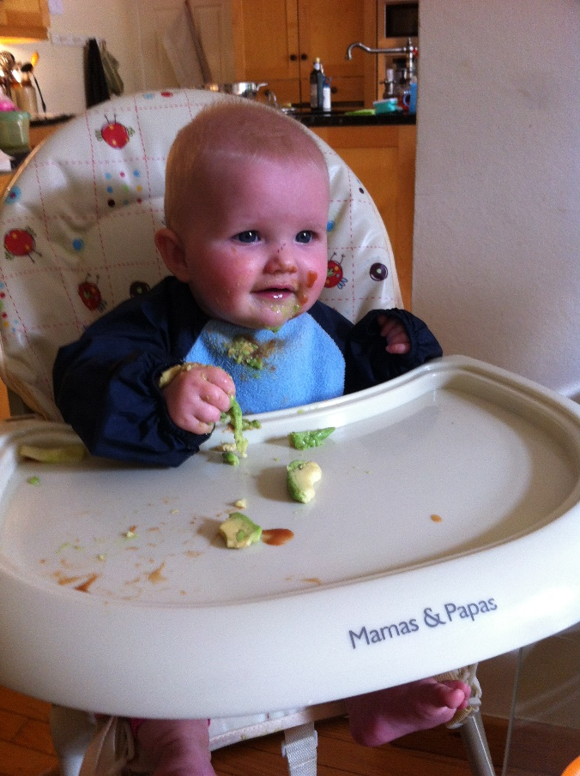
All in the best possible taste… aka Food and Drink Round

Slide 2

1. By what name is a courgette more commonly known in America?
A: Zucchini

Slide 3
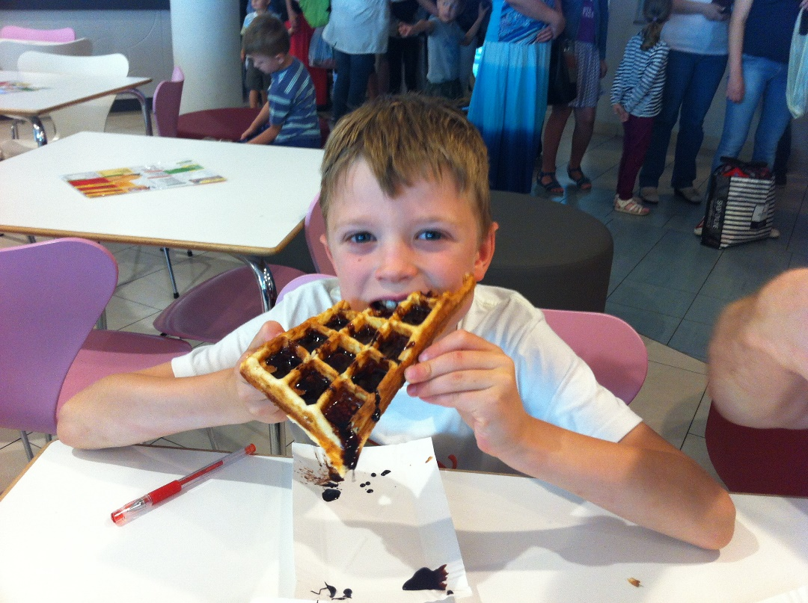
2. In 2014, Turkey, Ireland, and the UK rank first, third and fifth in the world in the consumption of what? (Wikipedia)
A: Tea

Slide 4
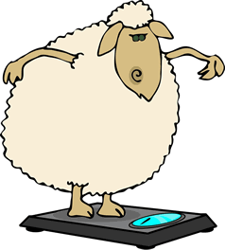
3. Haggis is a traditional Scottish sausage made from a sheep’s stomach stuffed with what 4 main ingredients? (excluding onions)
A: Sheep’s heart, liver, lung
Oats

Slide 5
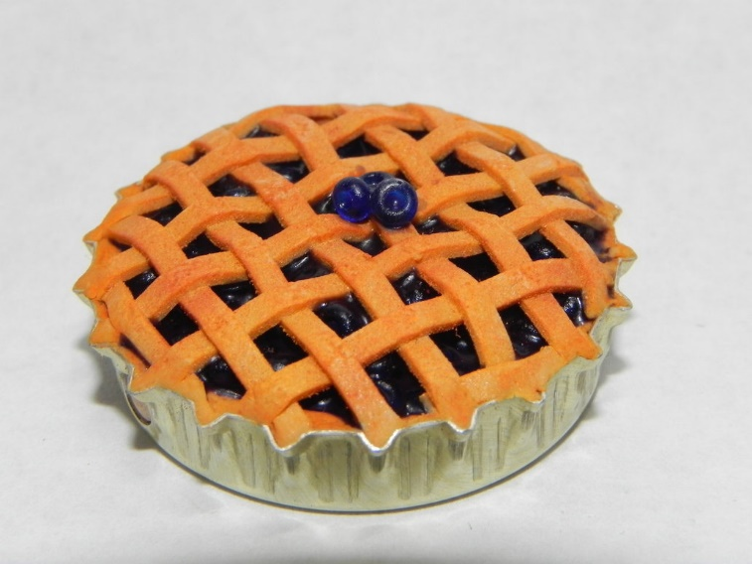
4. If apple pie is the official state pie of Vermont and blueberry pie of Maine, what is the official state pie of Florida?
A: Key Lime Pie

Slide 6
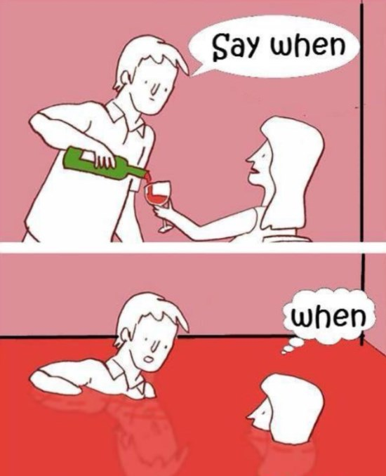
5. What part of a wine bottle is the punt?
A: The indentation at the base of the bottle

Slide 7
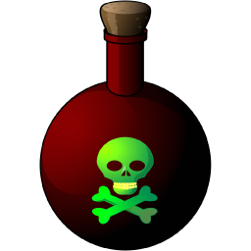
6. What poison is found in (small quantities!) in rice?
A: Arsenic

Slide 8
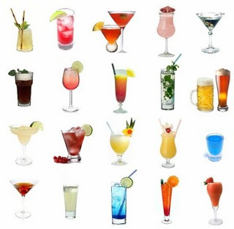
7. Name the popular drink that was invented by John Pemberton in 1886?
A: Coca Cola

Slide 9
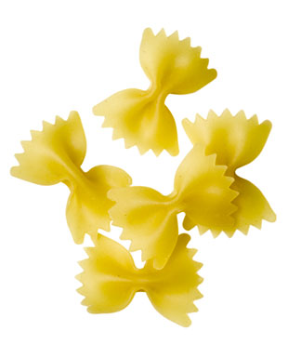
8. Name the pasta
A: Farfalle

Slide 10
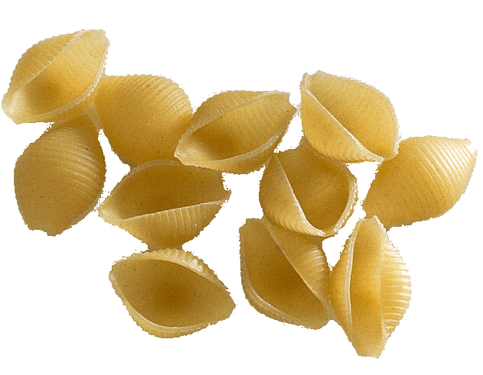
9. Name the pasta
A: Conchiglie

Slide 11
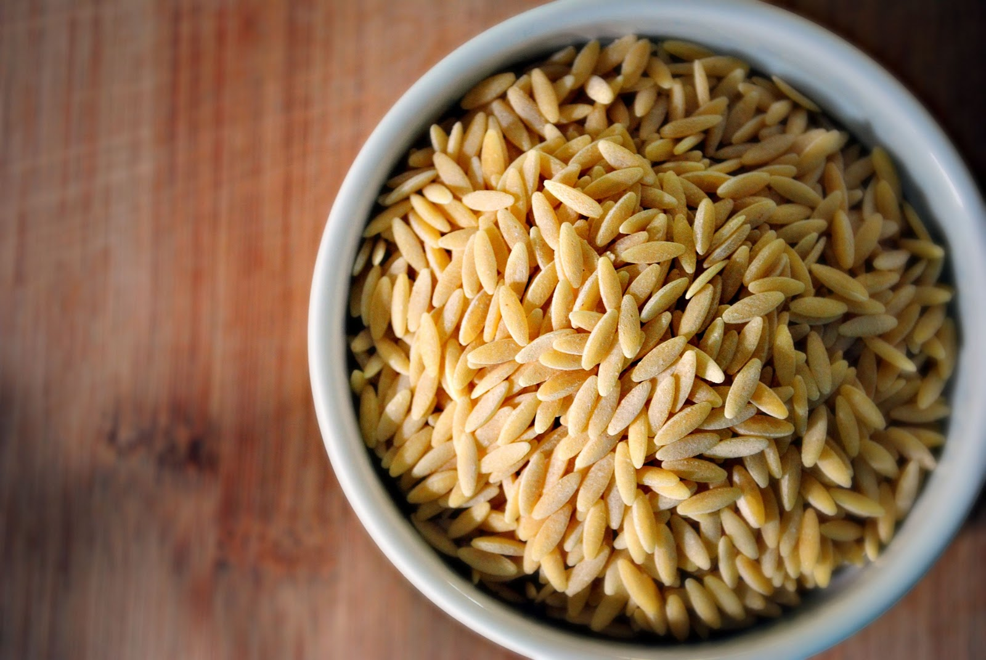
10. Name the pasta
A: Orzo

